Slide 1
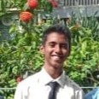
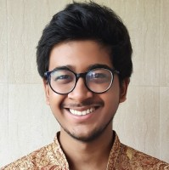
The Team
Tanay Patil
Gaurab Das
UC San Diego
Purdue University

Slide 2


Slide 3







Slide 4



Slide 5

THANK YOU!

